Slide 1
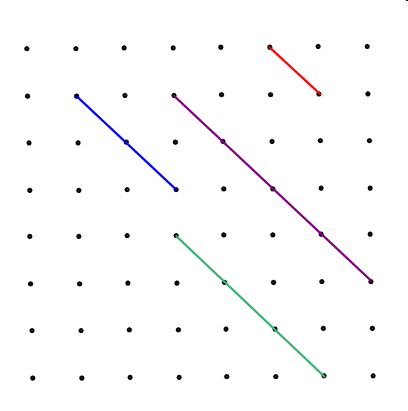
Surds
Calculate the length of each line.
Red line = √2
Blue line = √8
Blue line = 2 x red line
So √8 = 2√2 …

Slide 2
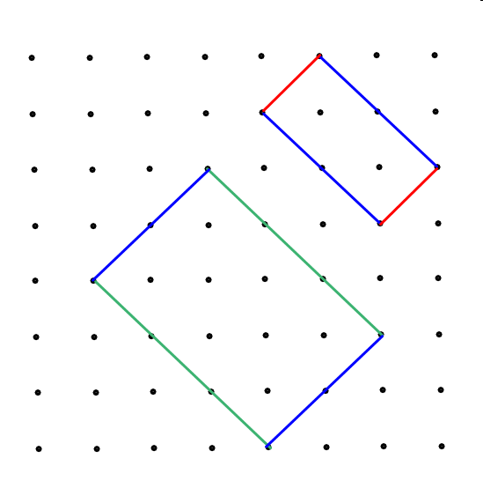
Calculate the area of each of these rectangles.

